Slide 1
Digital Signal Processing
Dr. Michael Nasief
Lec 3

Slide 2
System Properties
Linear Systems
A system that is both additive and homogeneous is said to be linear.

Slide 3
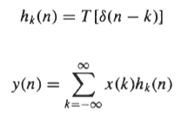
System Response

Slide 4
Shift-Invariance
If a system has the property that a shift (delay) in the input by no results in a shift in the output by no, the system is said to be shift-invariant.

Slide 5
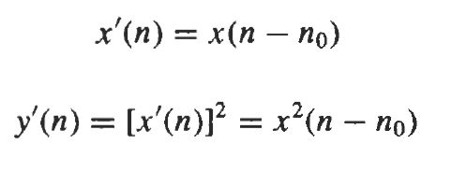
Example
So Shift Invariant

Slide 6
Example 2
System y(n) = x(n) + x(-n)
y (n-n0) = x(n-n0) + x(-n –n0)
If x1(n) = x(n-n0) Then
y1(n) = x(n-n0) + x(-n+n0)
So shift Varying
After
Before

Slide 7
Linear Shift-Invariant Systems
A system that is both linear and shift-invariant is referred to as a linear shift-invariant (LSI) system.

Slide 8
Causality
A system property that is important for real-time applications is causality, which is defined as follows:
Definition: A system is said to be causal if, for any no, the response of the system at time no depends only on the input up to time n = no.

Slide 9
EXAMPLE

Slide 10
Stability
In many applications, it is important for a system to have a response, y(n), that is bounded in amplitude whenever
the input is bounded. A system with this property is said to be stable in the bounded input-bounded output (BIBO)
sense. Specifically,
Definition: A system is said to be stable in the bounded input-bounded output sense if, for any input that is bounded

Slide 11
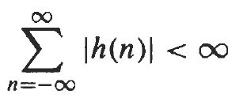
Note
For a linear shift-invariant system, stability is guaranteed if the unit sample response is absolutely summable:

Slide 12
Example
So System is stable

Slide 13
Example

Slide 14
lnvertibility
A system property that is important in applications such as channel equalization and deconvolution is invertibility.
A system is said to be invertible if the input to the system may be uniquely determined from the output.

Slide 15
Example

Slide 16
CONVOLUTION
The relationship between the input to a linear shift-invariant system, x(n), and the output, y(n), is given by the convolution sum
Reverse and shift

Slide 17
Convolution Properties
Commutative Property

Slide 18
Associative Property

Slide 19
Distributive Property

Slide 20
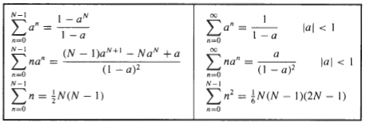
Performing Convolutions
Direct Evaluation

Slide 21
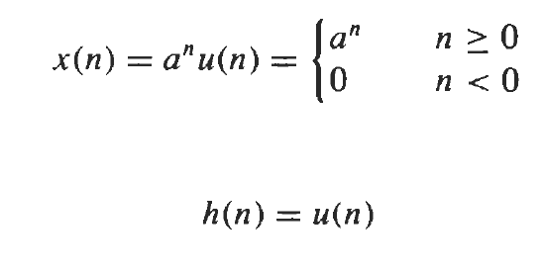
EXAMPLE

Slide 22
Graphical Approach
1. Plot both sequences, x(k) and h(k), as functions of k.
2. Choose one of the sequences, say h(k), and time-reverse it to form the sequence h(-k).
3. Shift the time-reversed sequence by n. [Note: If n > 0, this corresponds to a shift to the right (delay), whereas if n < 0, this corresponds to a shift to the left (advance).]
4. Multiply the two sequences x(k) and h(n - k) and sum the product for all values of k. The resulting value will be equal to y(n). This process is repeated for all possible shifts, n

Slide 23
Example

Slide 24
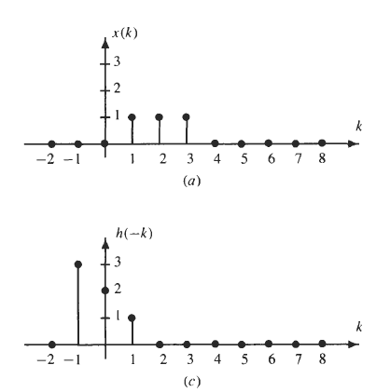
Y(0) = 1

Slide 25
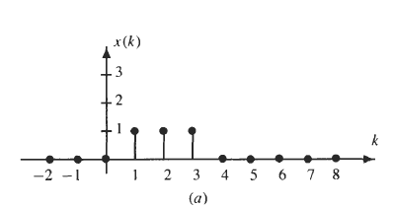
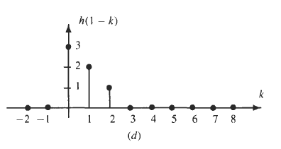
Y(1) = 3

Slide 26
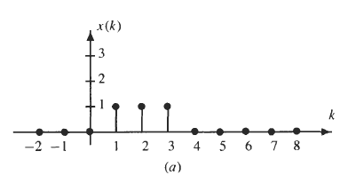
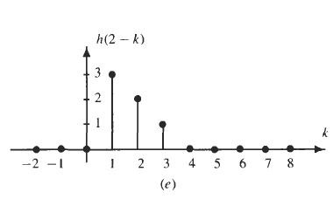
Y(2) = 6

Slide 27
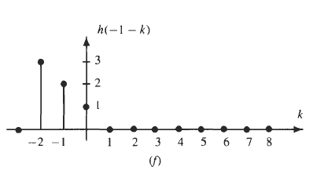
Y(-1) = 0

Slide 28
quiz
Get
The Remaining valued Y(n)
Then Draw it

Slide 29
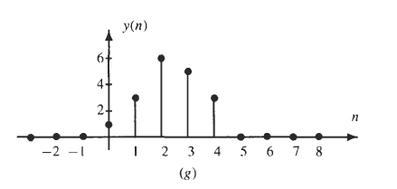
Y(n)

Slide 30
Note
The convolution of two finite-length sequences
if the nonzero values of x(n) are contained in the interval [ Mx, Nx] and the nonzero values of h(n) are contained in the interval [Mh, Nh], the nonzero values of y(n) will be confined to the interval [Mx + Mh, Nx + Nh].

Slide 31
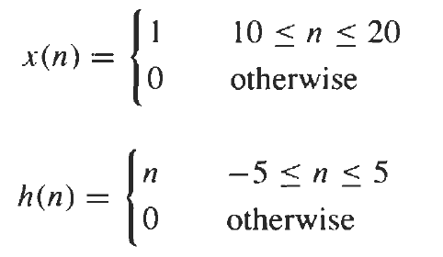
EXAMPLE

Slide 32
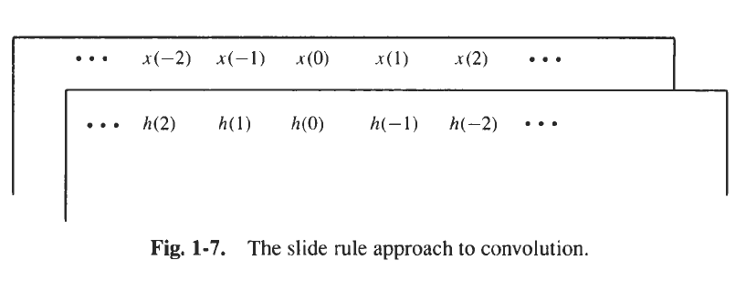
Slide Rule Method

Slide 33
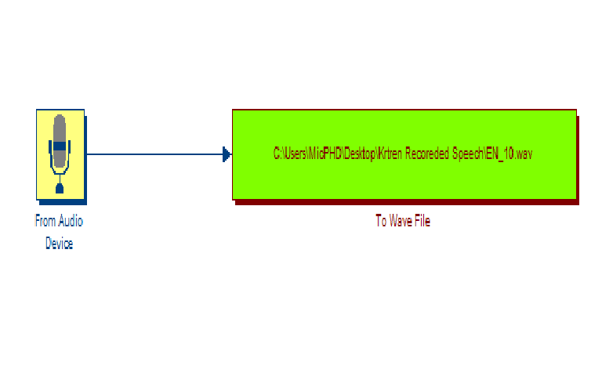
Recording the Speech.(Matlab)

Slide 34
Sampling Rate

Slide 35
File destination
Bits per Sample

Slide 36
How to play it from SIMULINK

